Slide 1
HNDIT1101: Personal Computer Applications
Week 05

Slide 2
What is spreadsheet?
A spreadsheet is simply a table or matrix of rows and columns, very similar to an accounting journal.
  Flexible
  Speed
  accuracy

Slide 3
Spreadsheet terms
Spreadsheets are made up of
  Columns
  Rows
  And their intersections are called cells
Each column is identified by the column letter
  A,b,c,………AA,BB,…..IV
Each row is identified by the row number
  1,2,3,…….,999.1000,…..63536

Slide 4
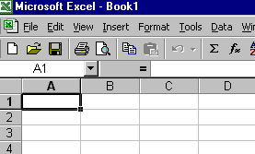
Cell Address
Current cell
A1
B2
A cell is identified by specifying its cell address which
is the co-ordinate of the intersection of a column and row.
(it is formed by combining the corresponding column
letter and the row number.)

Slide 5
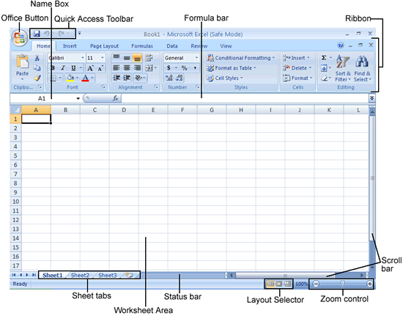

Slide 6
Cell pointer movement key
Up arrow - Up one cell
Down arrow - Down one cell
Left arrow - Left one cell
Right arrow - Right one cell
Home - Move to first cell in a row
Ctrl + home - Move to cell A1
Page up - One screen up
Page down - One Screen down
Ctrl+End - Move to first cell in a row

Slide 7
Select cells
If you want to select group of cells
  Place the cursor in cell A1
  Press the F8 key. This anchors the cursor.
  Note ‘EXT’ appear on the status bar in the lower right corner of the screen. You are in the extended mode.
  Click in cell E7.
  Press “Esc” key to exit.

Slide 8
Select cell ranges
Select a range
  Click the cell at one corner of the range and drag to the opposite corner of the range
Multiple range
  Select first range and hold the Ctrl key down and select the other range.
Whole row
  shift + spacebar
Whole Column
  Ctrl + spacebar
Notes:
Teach them how to add work sheet ,rename them

Slide 9
Worksheet formulas & functions
Relative Cell Addressing
  When the formula is copied to a different location, cell address in that formula changes relative to the movement of the formula.
=A1+B2 | =B1+C2
=A2+B3

Slide 10
Absolute Cell Addressing
When the formula is copied these cell address do not change
$A$1 Both row and column are absolute
=$A$1+B2 | =$A$1+C2
=$A$1+B3

Slide 11
Formula
Always start with equal (=)
Can use either relative or absolute cell address
Operators +,*,/,^,%
Functions sum(A1..A10), average(range) …. So on
Separate argument with comma
=sum(A3..A5,B3)
Argument can be constant
=sum(100,B3)

Slide 12
Operators
Arithmetic Operators
  You can enter numbers and mathematical formulas into cells. When a number is entered into a cell you can perform mathematical calculations such as addition, subtraction, multiplication, and division.
  + Addition
  - Subtraction
  * Multiplication
  / Division
  ^ Exponential

Slide 13
Comparison Operators
Compare tow values and produce logical values of TRUE or FALSE with these Operators
  = Equal
  > Greater Than
  < Less than
  >= Greater than or equal
  <= less than or equal
  <> Not equal to

Slide 14
Text Operator
& (Ampersand)
  Connects , or concatenates, two values to produce one continuous text value.
  Ex: “ ATI” & “,” &“Galle” produce “ ATI ,Galle”

Slide 15
Reference operators
Reference operators are helpful when referring to a cell or group of cells. Two types of reference operator are range or union.
  : (colon) for range
  , (Comma) for union

Slide 16
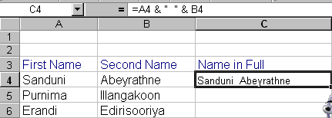
Example

Slide 17
What formula error value mean?
Microsoft Excel displays an error value in a cell when it can not calculate the formula properly. Error values always begin with a number sign (#).
  #Div/0! Is trying to divide by zero
  #N/A Refers to a value that is not available
  # Name? Uses a name that Excel dose not recognize
  #Null! Specifies an invalid intersection of two areas.
  #Num! Use a number incorrectly
  #Ref! Refers to a cell that is not valid
  #Value! Uses an incorrect argument or operand
  ##### Produces a result that is too long to fit in the cell. This is not actually an error value.

Slide 18
END

